Slide 1

Samsung Programming Language (SLang) – it is to be SW ecosystem
Oct, 2014 – Feb, 2015
Prof. Evgueni Zouev, M.Sc. Alexey Kanatov
Samsung R&D Institute Russia

Slide 2
Agenda
Driving factors for SLang
Industrial programming languages
Competitors’ trends
Samsung needs
Language Innovation approach:
parallel programming with classes protected with predicates
Expected benefits and opportunities (NABC)
Roadmap

Slide 3
Industrial programming languages
No single language covers majority of critical features!
SLang is to be the leap ahead!
Feature | Java | C# | C | Objec- tive C | C++ | SLang
General safety | Avg | Avg | Low | Low | Low | High
Efficiency | Low | Avg | High | Avg | High | High
Strong typing | Yes | Yes | No | No | Avg | Yes
OOP Support | Yes | Yes | No | Yes | Yes | Yes
Native/optimizing compilers | No | No | Yes | Yes | Yes | Yes
Garbage collection | Yes | Yes | No | Yes | No | Yes
Language/library support for parallelism | Yes | Yes | No | No | No | Yes
Modularity | No | No | No | No | No | Yes
Separate compilation | No | No | Yes | Yes | Yes | Yes
Overall language design | Avg | Avg | Bad | Bad | Bad | Best!
More details

Slide 4
Competitors trends
Innovations from new programming languages
Java – industrial usage 42%. ART – aims to get rid of Java performance bottlenecks. Go – server-oriented language
Objective-C – industrial usage 32%, SWIFT as a replacement
C# - industrial usage 10%, SPEC#, etc. – a family of research languages
Platform lock-in

Slide 5
Samsung need: How to strengthen Tizen?
Reliability ↑of applications development
Bug free code (C/C++:Low, C#/Java:Med, SLang: High)
Cost of ownership↓ (development and support)
C/C++: High, C#/Java: Med, SLang: Low-Med
Performance ↑
C/C++: High, HTML5, JavaScript: Low, SLang: High
Complexity ↓of parallel programming
C/C++: High, SLang: Low-Med
Extend Tizen SDK with SLang ecosystem to utilize 4 key differentiating factors

Slide 6
Samsung need: How to strengthen in-house SW development?
Reliability ↑of applications development
Bug free code (C/C++:Low, C#/Java:Med, SLang: High)
Cost of ownership↓ (development and support)
C/C++: High, C#/Java: Med, SLang: Low-Med
Performance ↑
C/C++: High, HTML5, JavaScript: Low, SLang: High
Complexity ↓of parallel programming
C/C++: High, SLang: Low-Med
Setup SLang ecosystem as Samsung SW development toolchain

Slide 7
Language Innovation approach
Reliability of applications development (3-5x higher)
Predicates (preconditions, postconditions, class invariants)
Type safety (conformance, conversions)
NULL safety (no more NULL pointer dereferencing)
Cost of ownership (development and support) (3-5x lower)
Inheritance with covariant conformance
Interoperability with existing SW
Modular, object-oriented and functional programming (3 in 1)
Performance (better than C++ code)
High-level language specific optimizations
LLVM-optimizing back-ends
Complexity of parallel programming (3-5x lower)
Parallel programming with classes => only 1 additional keyword
Auto-parallelization for routine bodies
Examples

Slide 8
Expected benefits and opportunities
Samsung’s Ownership: full control over the language and the toolchain, lock-in for developers
SW quality increase (product quality increase)
Brand Image: Confirm Samsung as global S/W company
Short SW product development cycle, lower cost of ownership
Ease of parallel programming is aligned with multi-core trend
Platform Basis for future S/W innovations

Slide 9
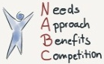
SLang NABC
Needs:
To support Tizen promotion covering all market segments from mobile, wearables, IVI to IoT with new programming eco-system to differentiate Tizen from other offerings
To suggest alternative to C/C++ programming for Android via NDK
To provide to Samsung for internal SW development simple and reliable eco-system fully controlled by Samsung
Approach:
To develop native code compiler LLVM-based + interpreter for the fast prototyping which can work with native libraries, then IDE and other tools
To reuse expertise and practical experience with C++ and Eiffel compilers development and programming languages design we have at SRR
Benefits:
Significantly reduce cost of SW development for Samsung and Tizen programmers.
Utilize modern multi-core Samsung HW with very easy programming model
Utilize(Reuse) already developed code in C/C++
Competitors:
C/C++ and legacy code
Java and its eco-system (Google)
C# and its eco-system (Microsoft)
Swift, Rust

Slide 10
SLang – how to proceed further
Samsung’s internal project: to apply for ADF funding, work with SWC and other business division (VD, printing, …)
SRR internship program: To develop SLang specification as “moonlighting” activity of enthusiasts and actual coding to be done by summer interns and future part-timers funded by SRR
Skolkovo (SK) opportunity: To use tax preferences for Skolkovo and start SLang project thru Skolkovo grants and separate Samsung legal entity (LE) as a place for Samsung SW innovations in Russia. Samsung in SK now. Samsung plan for SK.

Slide 11
Project roadmap: 15HRx15M
Implementation roadmap | Q1 |  |  | Q2 |  | Q3 | Q4 | Q5
Language design | 2HR
Compiler design and development (LLVM-based) | 3HR |  |  |  |  | 3HR
Runtime design and development |  | 1HR |  |  |  | 5HR
Libraries design and development |  | 1HR |  |  |  | 3HR
IDE integration (Eclipse) |  |  |  |  |  | 1HR
Integration and QA |  |  |  |  |  | 2HR
Documentation |  |  |  |  |  | 1HR
Phase I | Phase II
Deliverables roadmap | Q1 |  | Q2 |  | Q3 | Q4 | Q5
Language description | alpha | beta | final
Command-line compiler releases |  |  |  | alpha |  | beta | V1.0
Runtime releases |  |  |  | Hello world | Garbage collector
Libraries |  |  |  | design | alpha | beta | V1.0
SLang SDK for Tizen |  |  |  |  |  | alpha | V1.0

Slide 12
Long term view
SLang is to become the long term initiative similar to MS Visual Studio solution which lasts for years
Further language and environment development (e.g. mathematical verification of program correctness, different tools – from code coverage to alternative approach to GUI and WEB programming)
Support and enabling of SLang for Samsung internally, regular external releases. Open source or commercial models

Slide 13
Summary
Parallel programming with classes protected with predicates is to become industry standard for the software development to be set by Samsung
To strengthen Tizen promotion across markets segments including IoT – introducing the modern way of programming focusing on simplicity of development, code robustness, easy parallelism with classes and code performance
SRR has expertise and drive to start such activity and produce programming environment with set of libraries using 15x15 in 2015/2016 scheme or other business models
Current status – work in progress. Language concepts are being reviewed by Compiler committee: 7 of 14 reviewed. General spec readiness about 30-40% at the moment.
So radical today – so obvious tomorrow!

Slide 14
Some extra reasons for SLang…

Slide 15
Why do we need yet one more programming language?
Software becomes essential part of electronics – smartphones, tablets, TVsets, IoT – software is everywhere. SW is brains!
We continue to develop things’ “brains” with error-prone C/C++ code, we cannot fully use the power of existing and future HW limited by Java/C# (no balance between reliability and performance)
We have to rely on other companies to develop next version of the toolchain to power our HW. We follow and have to invest in others’ business growth.

Slide 16
It is difficult to innovate…
Think hard helps! ☺ Take the best from the best initiatives! (Reuse and improve)
Take modules from Modula-2/Ada, classes from C++/Java/C#/Eiffel and mix!
Take assertions and simple parallel programming from Eiffel and adopt!
Take functional programming concepts from Scala and adopt!
Analyze classes, interfaces, traits and steps up with own multiple inheritance solution
Analyze script languages and step up with own scalable program structure concept

Slide 17
SLang to cover all IoT segments
Current state
Nearest future
Terminal
Sensors
Very simple logic (if any at all)
Limited set of action types
No system & library calls
No need for pre- & postconditions
For all levels:
Extensive logic for all architecture levels
Full set of action types
Full set of data types & operations
Needs high-level of reliability
Needs support for reliable and fast concurrent processing
=> SLang as a common language for IoT software
Hubs
Simple logic
Many data types and operations
Needs significant level of reliability
Concurrency
Extensive logic
Full set of action types
Full set of data types & operations
Needs high-level of reliability
Concurrency
Servers & Rich Clients
Structured run-time is the basis for all segments

Slide 18
One SW ecosystem cross IoT segments
To reduce costs of the software maintenance.
To reduce costs of the SW development.
To provide the same level of software reliability.
To provide similar life cycle for all kinds of company software.
To reduce costs for teaching employees.
To apply the same development, coding and style rules for all SW products within the Company.
To improve employees’ retention.

Slide 19

SLang’s trinity and targets
Simplicity and flexibility
Reliability and reuse
Concurrency and performance
Tizen SDK
Android NDK
IoT SDK

Slide 20
SLang: key language concepts and capabilities
Modules, classes, routines, code sequences (reliability, flexibility)
Inheritance and usage (reuse, simplicity)
Assertions (reliability)
Scopes (simplicity, reliability)
Generics (simplicity, reuse)
Objects’ creation/declaration (simplicity), constructors (flexibility), NULL safety (reliability)
Tuples (flexibility, simplicity)
Lambda – functional programming (flexibility, reliability)
Simple concurrency (simplicity)
Smart interfacing with 3rd parties’ code – (reuse)
Native code compilation and optimizations (performance)

Slide 21
Backup

Slide 22
Tizen
http://live.sec.samsung.net/content/forwardGlobalContentDetail.do?seqId=401422

Slide 23
Why should Samsung think about new language?
General background:
Samsung is mature and powerful company enough to design, develop, maintain and evolve its own codebase.
The global leader in electronics must not be a permanent “follower” in software.
An application programming language for Samsung – is just a first step towards getting the “software independence”.
Back

Slide 24
Why New Languages?
Existing languages have lots of disadvantages: they are archaic, unsafe, inefficient, awkward and too complicated and hard for programming & maintenance… Companies (& developers) are not happy about them.
Existing languages are not suitable for solving current problems (e.g. web prog, concurrency etc.)
The language evolution is under the control of third parties. Companies promoting new languages prefer to keep tools they use under their own control.
New languages are considered as a means for vendor lock-in, for software solution protection, and for developer’s retention.
Back

Slide 25
Why New Languages?
There are some glaring flaws of JavaScript, see slides at the end of the backup section.
For defects and pitfalls of C++, refer to well-known “A Critique of C++” by Ian Joyner, http://www.literateprogramming.com/c++critique.pdf, and many other publications. (See also Stroustrup’s Design and Evolution of C++ for some criticism of both C & C++ design.)
Back

Slide 26
Example1: Parallel programming with classes
Parallel programming can be more easy!
High-level(class-level) parallelism
: done by the SW developer describing which object will be handled by another processing element. Only 1 keyword in the language.
Low-level(routine-level) parallelism
: done automatically within the class routines by the compiler
a: separate A = new A();
a.procedure_fromA_call (); //async call
b := a.function_from_A_call (); // sync call
for (integer i := 1 to n) {
// compiler is to identify if the loop body can be // executed in parallel
}
Back

Slide 27
Example2: Programming with classes & predicates
Low complexity of debugging
: Stating program correctness and checking it at run-time allows dramatically minimize the complexity of debugging
: Every access to class routines is protected with predicates
class A
routine_foo (arg1: T1; arg2: T2) is
require
predicate1; predicate2;
// routine body
ensure
predicate3; predicate4;
end
invariant
predicate5; predicate6;
end
Predicate: In mathematics, a predicate is commonly understood to be a Boolean-valued function P: X→ {true, false}, called the predicate on X. Informally, a predicate is a statement that may be true or false depending on the values of its variables. E.g. arg1 == arg2 is a predicate
Back

Slide 28
Cost of ownership
Assessing Programming Language Impact on Development and Maintenance: A Study on C and C++: Billions of dollars are spent every year for building and maintaining software. To reduce these costs we must identify the key factors that lead to better software and more productive development. One such key factor, and the focus of our paper, is the choice of programming language. Existing studies that analyze the impact of choice of programming language suffer from several deficiencies with respect to methodology and the applications they consider. For example, they consider applications built by different teams in different languages, hence fail to control for developer competence, or they consider small-sized, infrequently-used, short-lived projects. We propose a novel methodology which controls for development process and developer competence, and quantifies how the choice of programming language impacts software quality and developer productivity. We conduct a study and statistical analysis on a set of long-lived, widely-used, open source projects—Firefox, Blender, VLC, and MySQL. The key novelties of our study are: (1) we only consider projects which have considerable portions of development in two languages, C and C++, and (2) a majority of developers in these projects contribute to both C and C++ code bases. We found that using C++ instead of C results in improved software quality and reduced maintenance effort, and that code bases are shifting from C to C++. Our methodology lays a solid foundation for future studies on comparative advantages of particular programming languages. http://www.cs.ucr.edu/~neamtiu/pubs/icse11bhattacharya.pdf

Slide 29
Cost of ownership
Total Cost of Ownership: A Comparison of C/C++ and Java, 08/08/2007
Abstract
Programming language preference is a favorite debate among developers. Because different languages offer different coding styles, as well as different resources and tools, choosing between languages like C/C++ and Java can come down to developers' personal preference and comfort. But for businesses looking to implement one of these languages, how are they supposed to decide which language to go with? In most cases, it comes down to the bottom line.
Determining the total cost of ownership of C/C++ versus Java development is a complex equation that involves a number of factors, including development time, ease of maintenance, availability of developers, and hard costs like licensing and support. A recent survey of C/C++ and Java developers conducted by Evans Data Corporation reveals that Java is generally considered cheaper. This is because, in the developers' experience, Java allows for quicker deployment and maintenance compared to C/C++, which can take 50 percent longer. With a development team of 20 people, this can add up to more than $800,000 a year. In the opinion of many developers, Java tools have more features and allow for greater productivity. Developers familiar with both languages also gauge C/C++ licensing and support to be more expensive than Java licensing and support.
In summary, Java presents a compelling business case for businesses looking to choose a development language. For more detail on the findings of this report, please refer to the full article
http://www.oracle.com/technetwork/articles/entarch/cost-of-ownership-088625.html?ssSourceSiteId=otnjp

Slide 30
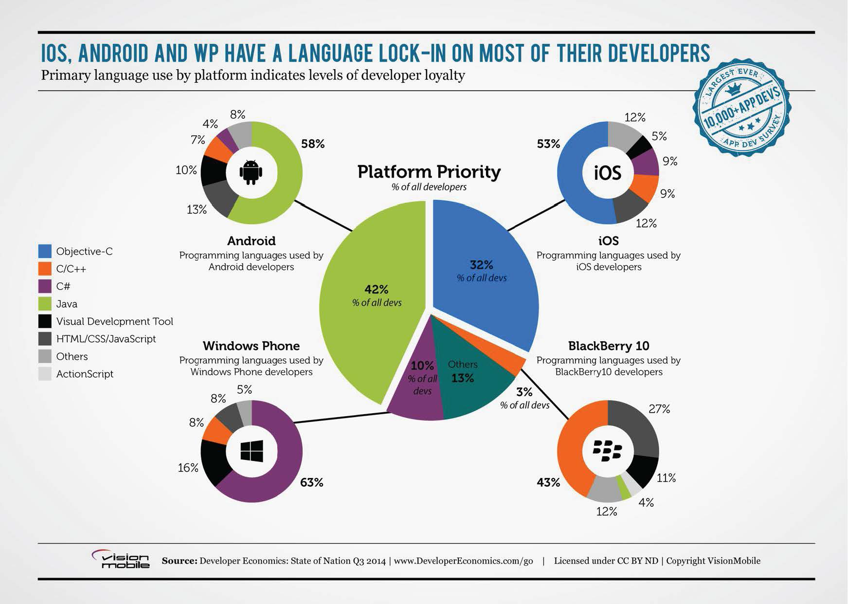
Industrial programming languages
Back

Slide 31

Swift: Overview
It was created for iOS and OS X apps development
Based on Objective C language with simplified syntax
Objective-C and Swift files can coexist in a single project
Compiled to native code using LLVM infrastructure
Swift is a statically-typed language
Swift provides object-oriented features such as classes, protocols, and generics
Swift supports many modern features: type inference, automatic references counting (ARC), closures, extensions, optionals, etc.
Designed for safety: variables are always initialized before use, arrays and integers are checked for overflow, and memory is managed automatically (with ARC)

Slide 32
JavaScript
JavaScript – the widely-used (if not the single) language for writing web apps, and…
– ONE BIG MISTAKE
“Lisp in C-like clothes”: An experimental & research language pushed to the very “industrial” area.
A bright example of personal taste claiming to become an industrial standard for developers.
Historical reasons & human’s (developer’s) conservatism: it seems hard (really? ☺) and expensive (?) to switch to another language.
Awkward syntax together with overcomplicated semantics (just have a look at the ECMA-262 standard!).
Overcomplicated and tricky dynamic semantics (dynamic typing is just a part of it) is the permanent source of runtime errors.

Slide 33
JavaScript: Funny & Weird Features
No block scope
var x = 1; { var x = 2; } alert(x); // outputs 2
Functions are objects
fn = function(x) { ... } // fn is a function... fn.foo = 1; // ...and has a property ‘foo’... fn.next = function(y) { ... } // ...and has a property ‘next’ // which is in turn function!
My thanks to Andrew Shitov for good JavaScript examples.

Slide 34
JavaScript: Funny & Weird Features
Hoisting
var a = 10; (function(){ alert(a); // undefined! var a = 20; // declaration ‘var a;’ goes to the // beginning of the scope (up) // and here we actually have // assignment ‘a = 20;’ })();
function foo() { alert(1); } foo(); // alerts 2! function foo() { alert(2); }

Slide 35
JavaScript: Funny & Weird Features
‘This’ ambiguity
var x = 10; var foo = { x : 20, bar : function() { var x = 30; return this.x; } };
console.log( foo.bar(), // outputs 20 (foo.bar)(), // outputs 20 (foo.bar = foo.bar)(), // outputs 10 (foo.bar, foo.bar)() // outputs 10 );

Slide 36
JavaScript: Funny & Weird Features
Comma operator
var a = (1,5 – 1) * 2; // result is a = 8
Dangerously reminds the old and terribly famous Fortran error:
DO I = 1.5 ...

Slide 37
SLang’s trinity
Simplicity ☺
Reliability
Concurrency

Slide 38
SLang: key concepts and advanced capabilities
Program structure and components +
Collections +
Compilation +
Relations between collections +
Accessibility +
Generics +
Creation of objects, constructors, NULL safety +
Assertions
Exceptions
Tuples
Lambda (routines as 1st class citizens)
Simple concurrency
Predefined classes
Interfacing with 3rd parties

